Slide 1
Menu planning Week 2 Gr. 11 Principles to consider when planning the content of the menu
Vary ingredients:
Do not
Never repeat basic ingredients
Do not serve too many heavy, starchy items
Do not serve too many rich foods
Do not serve vegetables from the same family

Slide 2
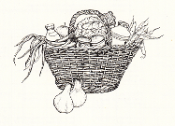
vary
Texture
Temperatures
Flavours
Colours
Shapes
Cooking methods

Slide 3
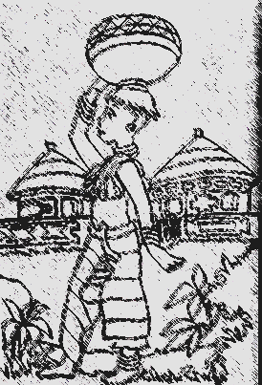
1.2 Type of customers
Age
Religion or ethical issues
Nationality / culture
Preference and needs
Special nutritional needs
Gender
Job / career

Slide 4
1.3 management
Type of establishment
Type of meal
Time of the year
Summer / winter
Festive holidays
Availability of food
Seasonal
Locally available

Slide 5
continue
Costing
Space and equipment in the kitchen
Amount and skills of staff
Complete utilisation of food
Time for preparation
Standardised recipes and tested recipes

Slide 6
1.4 Nutritional Considerations
Basic knowledge of nutrition
Provide nutritious food and a balanced menu
Satisfy all nutritional needs
Daily all six basic food groups
In the correct amounts
Classify food according to most important nutrient
Drink 6-8 glasses of water daily
Use the food pyramid as guideline

Slide 7
Food pyramid
Fats, oils and sugar
Meat and meat alternatives
Milk and milk products
Fruit
Vegetables
Cereals and starch products

Slide 8
Important words
Nutrients are
Chemical compounds in food
Function
Build and repair
Supply heat and energy
protection

Slide 9
2. Writing out a menu
Appearance and writing out a menu can determine the initial response
Correct and professional
Neat and readable
According to the rules for Table d’ Hôte menu
Don’t use a mixture of languages
Label dishes accurately
Spell correctly
Don’t use brand names
Short, clear description
Don’t write down unnecessary accompaniments
List the beverages

Slide 10
Writing out a menu
MENU FORMAL DINNER STARTER
Avocado Ritz
MAIN COURCE
Pepper Filet
Château Potatoes
Roast Vegetables
DESSERT
Chocolate Mousse
COFFEE/TEA
2 January 2014
Write the word MENU on the top of the page
(uppercase, bold, centralised)
Write down the type of meal
List the courses or dishes in the order of serving
Show courses
List the dishes in the main course in the correct sequence : protein, starch, vegetables and salad
Capital letters for each course
List the beverages at the end of the menu
Indicate the date of the meal. Write the month in full

Slide 11
Planning a tea party
Middle to late afternoon
Also in the morning
For special occasions, e.g. a christening
Formal or informal
Is a between-meal snack
British tradition serves high tea
Set covers
Late afternoon or early evening 17h00-19h00
Serves as a supper
In hotels / tea gardens / restaurants

Slide 12
1. Planning a tea party
Choose a date
Send invitations
Purchase accessories
Plan your menu
Search for recipes
Set the table:
Centre piece
Fine decorations
Brew the tea

Slide 13
2. Tea and accompaniments
Choosing menu and accessories remember:
Cultural preferences
Medical conditions
Season and weather
Sweet and savoury dishes
Different tastes
Food colours
Flavours
Bite sizes
Presentation

Slide 14
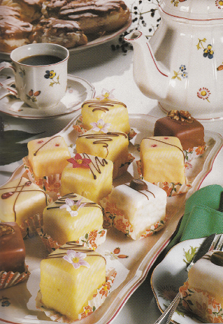
The following should be included
‘Dainties”
(on top of three-tier
stand)

Slide 15
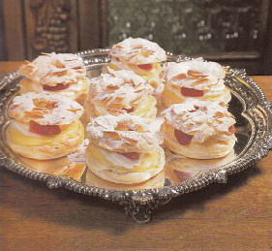
sweets
Middle tier of three-tier
stand

Slide 16
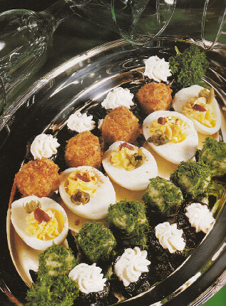
Savouries
Savouries on the
bottom tier of the
three tier stand

Slide 17
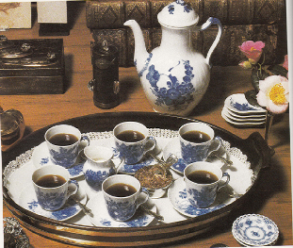
3. Different types of teas
Different types of teas
Earl grey
Rooibos
Ceylon
Jasmine
Other flavours
In stead of tea, serve:
Apple or other juices
Warm chocolate
Lemonade

Slide 18
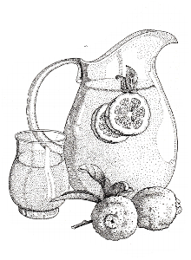
Accompanies that can be served with tea
Prepare tea with
apple juice
Dried orange peel
added to the teapot
Tangerine slices
studded with cloves
Fresh raspberries
or strawberries

Slide 19
Planning a three-course menu
Compiling:
Plan a balanced meal.
Start with the main dish ( protein dish)
Then the starch dish, vegetable dish, and salad.
Then plan the dessert.
Plan the starter now.
Choose the type of menu.

Slide 20
Types of menus
ttttttt
Table d’ Hôte | A la Carte
Fixed number of courses | Select any number of courses
No or few choices | Choice of dishes
Set price | Priced individually
Ready at a specific time | Waiting time
Prepared ahead of time | Cooked to order

Slide 21
Different menu types
Modern menu | Menu today
Starter | Starter
2. Soup | 2. Entrée
3. Fish | 3. Main course
4. Sorbet | 4. Cheese
5. Main course | 5. Dessert
6. Dessert | 3-4 course in afternoon 4-5 for dinner
7. Cheese | Sorbet between entrée and main course to refresh the palette. Cheese before or after dessert
 | Coffee is served with petit fours/friandise

Slide 22
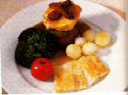
Dinner menu
A la carte or table d’ hôte
Serve more substantial food
Guest choice
3 course meal
Coffee

